Slide 1
Credit Scoring Model
Machine Learning Project

Slide 2


Agenda
Introduction , Scope
Importing dependencies
Dataset Features
EDA (exploratory data analysis)
Visualizations
Dealing with null values
Feature scaling
Algorithms
Hyperparameter tunning
Cross validation
AOC-ROC curve
Conclusion
A

Slide 3
Introduction
In this project, we aim to leverage machine learning techniques to develop a robust credit scoring model for a banking institution. The primary objective is to empower the bank with data-driven insights, enabling more informed lending decisions. Credit scoring plays a pivotal role in assessing the creditworthiness of loan applicants, and our focus is on building a predictive model that enhances the accuracy and efficiency of this process.

Slide 4
Scope:
"The scope of this project encompasses the development and implementation of a credit scoring model that predicts the likelihood of loans being classified as 'good' or 'bad.' Our analysis will involve exploring and preprocessing relevant data, selecting appropriate machine learning algorithms, and fine-tuning model parameters to achieve optimal performance.

Slide 5
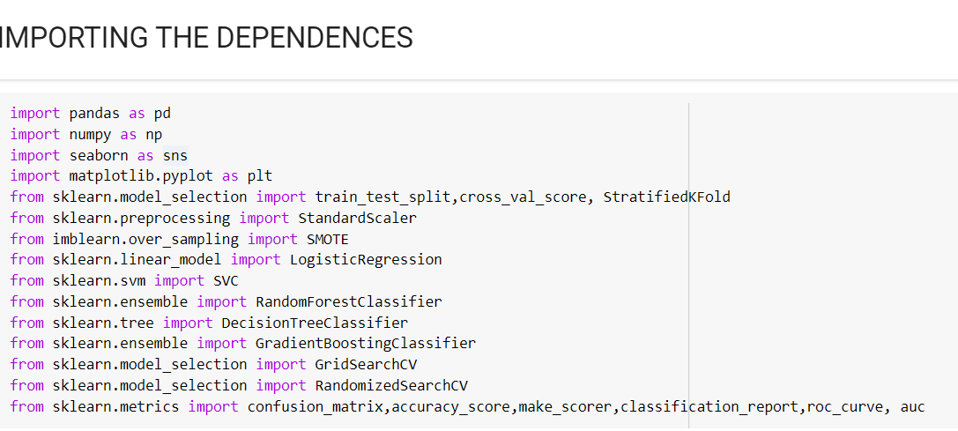
Importing Dependencies
Importing Essential Dependencies for Seamless Execution.
Pandas Library :-
It is useful for Data Processing and Analysis.
Numpy :-
It is a Python library used for working
with Arrays.
Matplotlib.pyplot :-
It is useful for making Plots.
Seaborn :-
It is useful for Data Visualization.

Slide 6
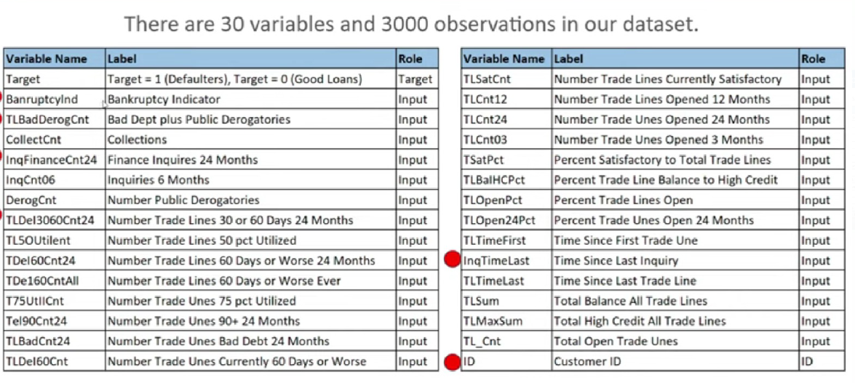
Dataset Features

Slide 7
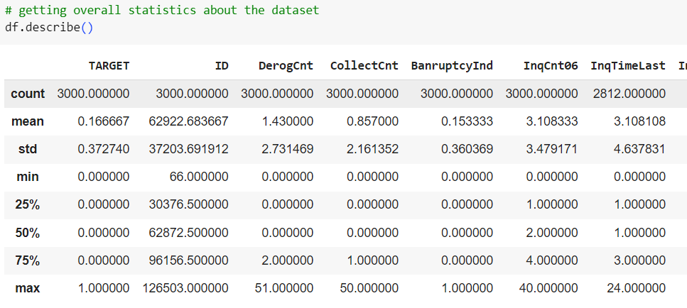
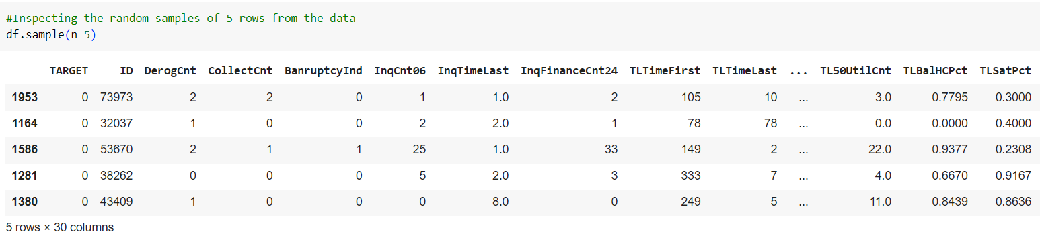
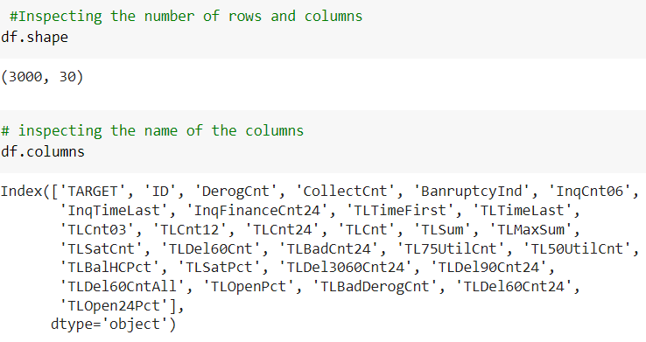
EDA (Exploratory Data Analysis)
It is an approach used for data sets in-order to summarize their important Characteristics .
EDA mainly target towards representation of the data in the graphical format.
To support the selection of proper statistical
Tools and techniques.
To provide a base for data collection in future by considering surveys and experiments.

Slide 8
Visualizations
Exploring the Data Distribution: Utilizing Seaborn, a powerful visualization library, we conducted a detailed analysis of the dataset's distribution.
Seaborn's capabilities allowed us to generate insightful visualizations, including distribution plots, histograms, and kernel density estimations, providing a comprehensive view of the data's spread and central tendencies.
These visualizations serve as critical tools in our analytical arsenal, enabling us to make informed decisions based on a thorough understanding of the data's distribution and underlying structures.

Slide 9
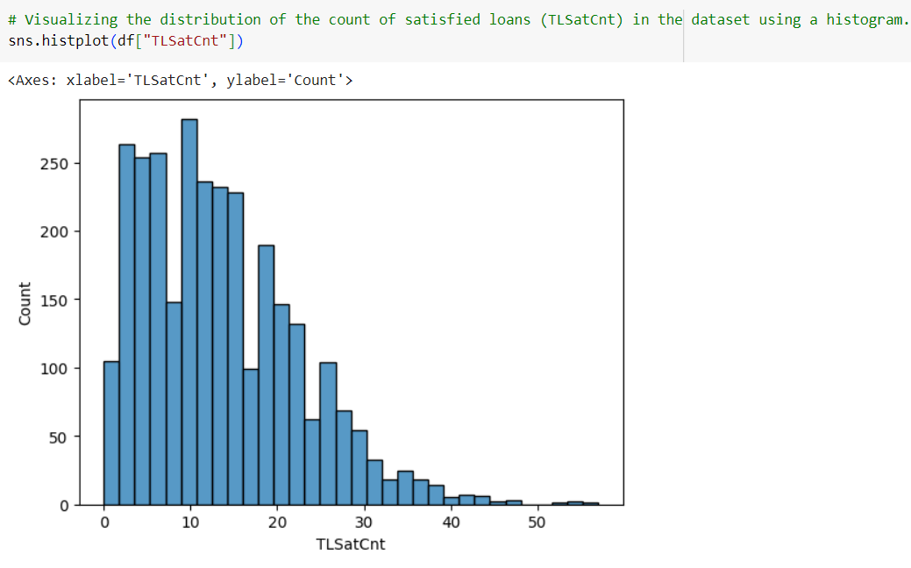
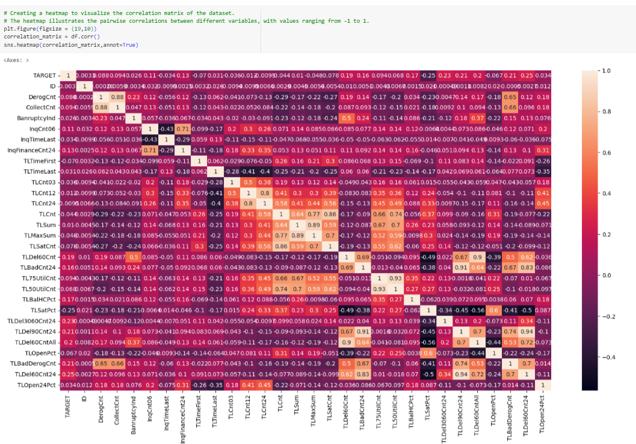
Visualizations of data

Slide 10
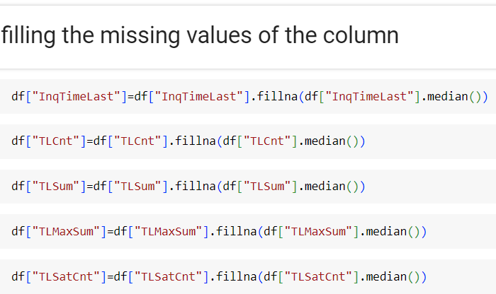
Dealing with null values
A critical aspect of our data preprocessing involved meticulous handling of missing values.
Utilizing a systematic approach, we identified and assessed the presence of null values across the dataset.
To ensure data integrity and maintain the robustness of our analysis, we implemented strategic techniques for handling missing data.

Slide 11
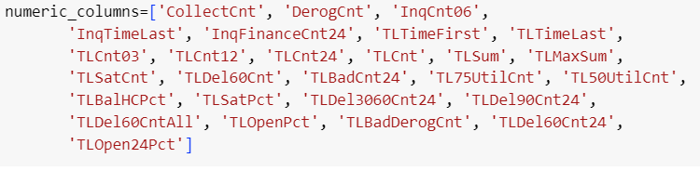
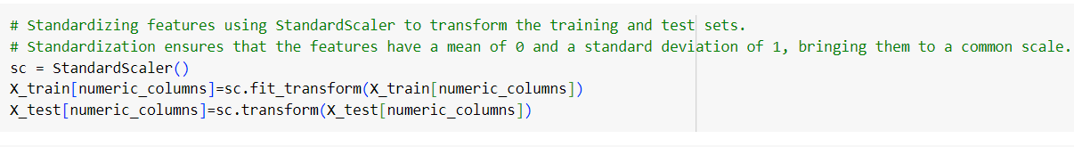
Feature Scaling
Rigorous preparation of our dataset included the application of Standard Scaler to numeric features.
This essential step in data preprocessing standardized the scale of variables, mitigating potential biases and ensuring a consistent magnitude across the dataset.
The deployment of Standard Scaler is paramount for models that are sensitive to the scale of input features, such as those utilizing distance-based metrics.
By transforming our numeric data into a standardized format with zero mean and unit variance, we've provided our machine learning algorithms with a foundation for improved convergence and performance.

Slide 12
Algorithms
Algorithms used in my projects are :
logistic regression
Decision trees
Random forests
Support vector machines
Gradient boosting

Slide 13
"Algorithmic Exploration: Our project delved into a diverse set of machine learning techniques to uncover optimal predictive models. The utilization of Logistic Regression laid the groundwork for interpreting linear relationships within the data, providing a transparent insight into the likelihood of outcomes.
Moving beyond, Decision Trees introduced a tree-like model structure, capturing intricate decision paths and enabling a deeper understanding of variable importance.
Random Forests, a powerful ensemble method, harnessed the collective strength of multiple decision trees, enhancing predictive accuracy and robustness.
Venturing into the realm of Support Vector Machines (SVM), our analysis incorporated a method well-suited for both linear and non-linear classifications. SVM's ability to delineate complex decision boundaries contributed to a nuanced exploration of our dataset.
Additionally, the integration of Gradient Boosting further enriched our predictive capabilities. This ensemble method sequentially builds weak learners, refining model accuracy with each iteration.
Our approach to algorithmic selection reflects a comprehensive strategy, leveraging the strengths of diverse models to address the nuances of our dataset. This meticulous exploration ensures a nuanced understanding of the data and underpins our commitment to precision and accuracy in predictive modeling.

Slide 14
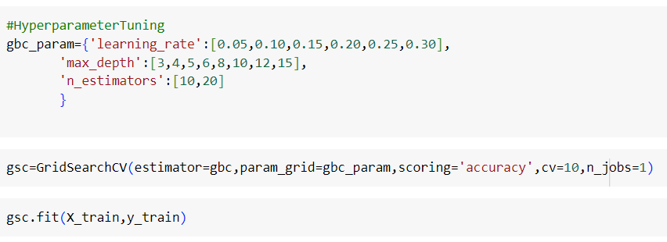
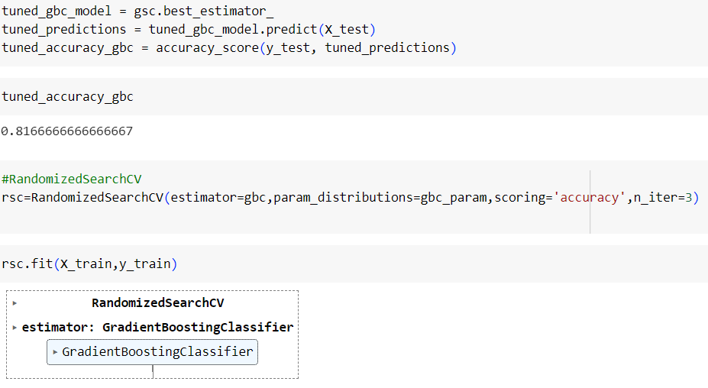
Hyperparameter tunning
Elevating our predictive models to peak efficiency, we embarked on an exhaustive journey of hyperparameter tuning.
Recognizing the pivotal role of hyperparameters in shaping model behavior, we meticulously explored and optimized these parameters to extract the utmost performance from our machine learning algorithms.
This meticulous tuning process involved systematically searching through the hyperparameter space, utilizing techniques such as GridSearchCV and RandomizedSearchCV.
Our goal was to unearth the ideal combination of hyperparameters that maximizes model accuracy, generalization, and overall effectiveness.

Slide 15
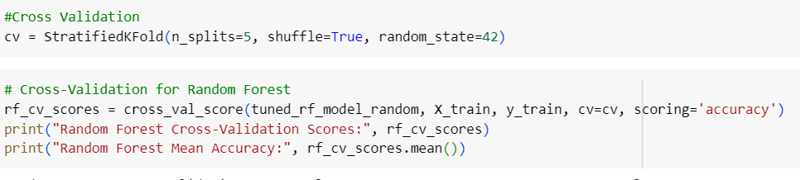
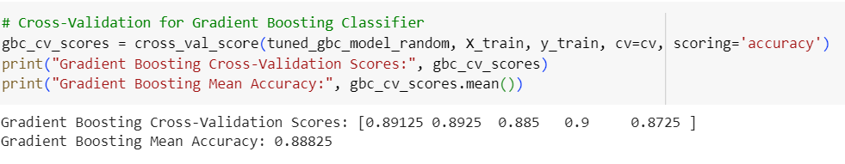
Cross Validation
Cross-validation serves as a critical component in our evaluation process, mitigating the risk of overfitting and providing a more accurate assessment of model performance.
Through techniques such as Stratified k-fold cross-validation, we partitioned our dataset into multiple subsets, iteratively training and validating our models on distinct folds.
This meticulous process not only guards against the variance in performance but also furnishes a more comprehensive understanding of how our models generalize to unseen data.

Slide 16
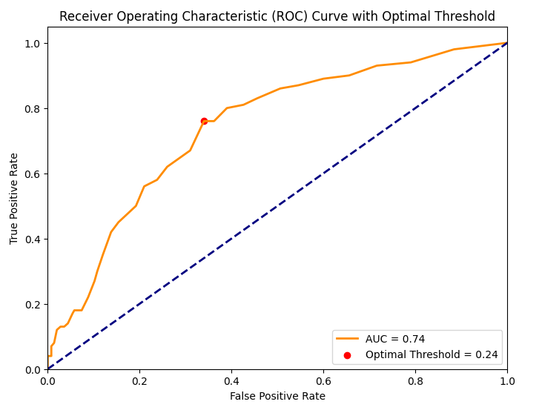
AOC-ROC Curve
By scrutinizing the Area Under the Curve (AUC) and Receiver Operating Characteristic (ROC) curve, we identified the thresholds that strike an equilibrium between true positive rates and false positive rates.
This strategic threshold selection enhances the model's ability to discern between positive and negative instances, tailoring its predictive behavior to align with the specific objectives of our project.

Slide 17
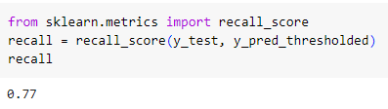
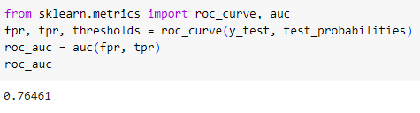
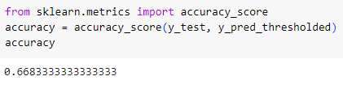
Conclusion
our comprehensive approach to data preprocessing, algorithmic selection, and meticulous model optimization has resulted in a predictive model that exhibits heightened accuracy, robustness, and adaptability. Notably, the strategic selection of decision thresholds, informed by AUC-ROC curve analysis, has fine-tuned our models to align with specific project objectives

Slide 18
Thank you

